Slide 1
R Programming Basics
M Nouman Durrani

Slide 2
R Programming
R is a programming language developed by Ross Ihaka and Robert Gentleman in 1993.
R programming language is widely used by data scientists and major corporations like Google, Uber, Airbnb, Facebook etc. for data analysis.
R possesses an extensive catalog of statistical and graphical methods.
It includes machine learning algorithm, linear regression, time series, statistical inference, etc.
Most of the R libraries are written in R, but for heavy computational task, C, C++ and Fortran codes are preferred.

Slide 3
Should you choose R?
A programming language is a tool to compute and communicate your discovery.
Most of the Data scientists use two excellent tools: R and Python.
The most important task in data science is the way you deal with the data: import, clean, prep, feature engineering, feature selection.
Learning statistical modeling and algorithm is far more important
This should be your primary focus.

Slide 4
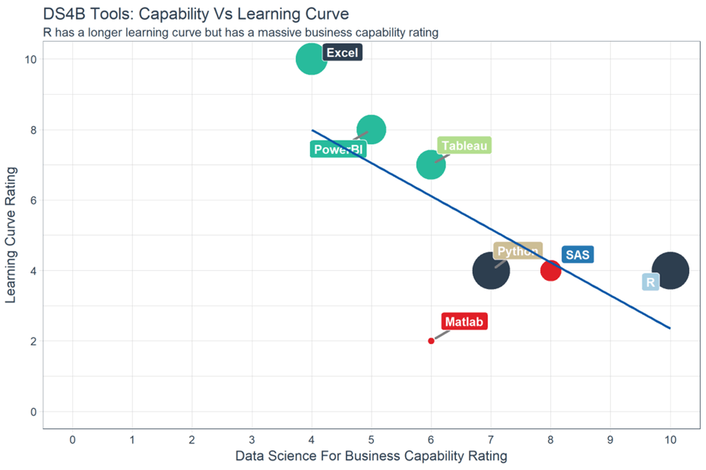
Excel and PowerBI: These two tools are simple to learn but don't offer outstanding business capability, especially in term of modeling.
SAS is a dedicated tool to run a statistical analysis for business, but it is not free. SAS is a click and run software.
Python, however, is a language with a monotonous learning curve. Python is a fantastic tool to deploy Machine Learning and AI but lacks communication features.
With an identical learning curve, R is a good trade-off between implementation and data analysis.

Slide 5
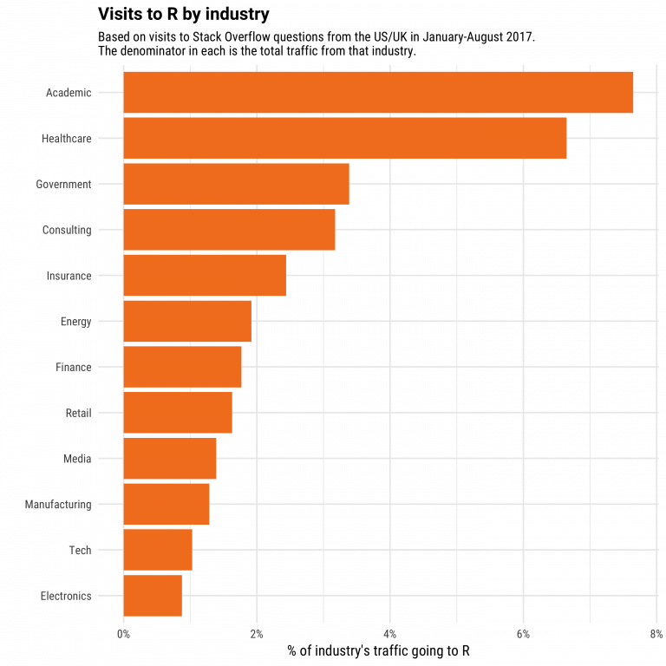

Slide 6
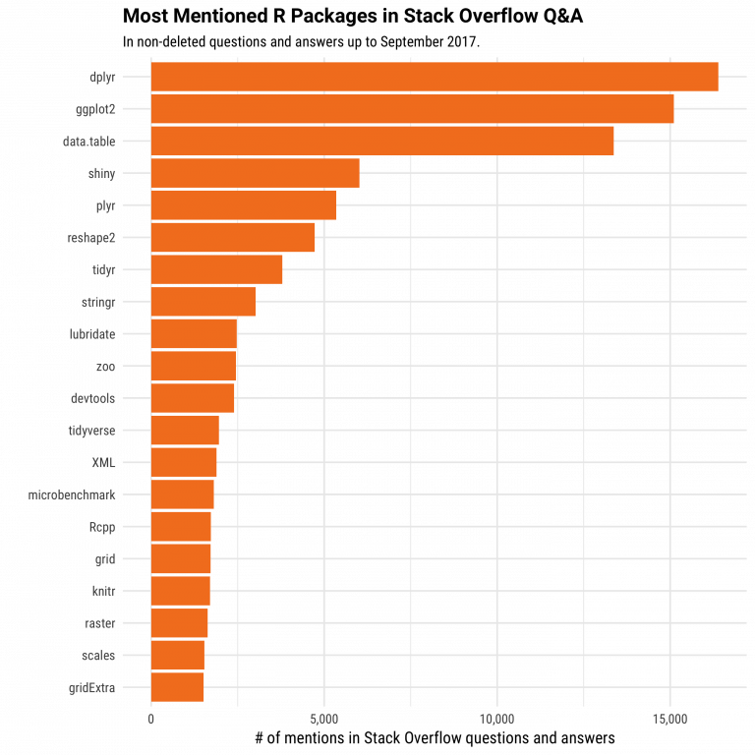

Slide 7
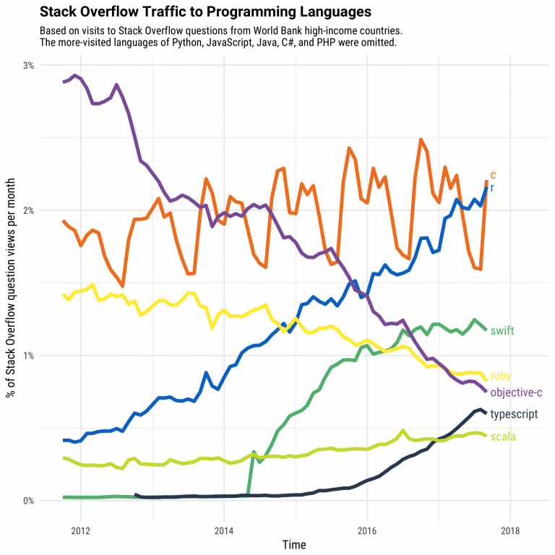

Slide 8
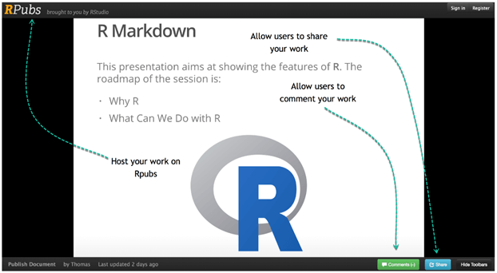
Communicate with R
R has multiple ways to present and share work, either through a markdown document or a shiny app. Everything can be hosted in Rpub, GitHub or the business's website.
Below is an example of a presentation hosted on Rpub

Slide 9
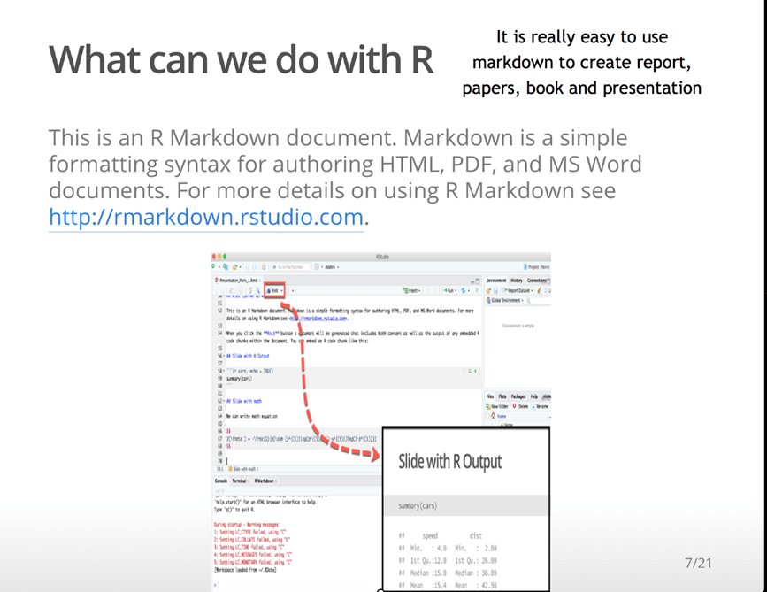

Slide 10
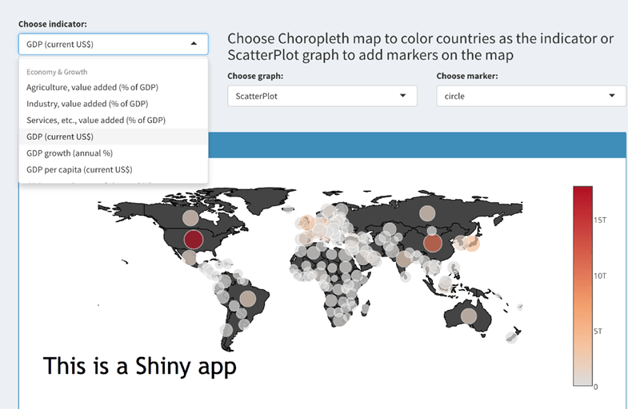
Rstudio has a great tool to create an App easily. Below is an example of app with the World Bank data.

Slide 11
Data analysis with R
Data analysis with R is done in a series of steps; programming, transforming, discovering, modeling and communicate the results
Program: R is a clear and accessible programming tool
Transform: R is made up of a collection of libraries designed specifically for data science
Discover: Investigate the data, refine your hypothesis and analyze them
Model: R provides a wide array of tools to capture the right model for your data
Communicate: Integrate codes, graphs, and outputs to a report with R Markdown or build Shiny apps to share with the world

Slide 12
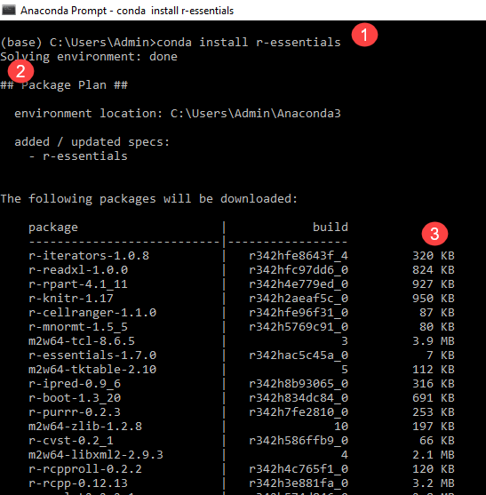

Slide 13
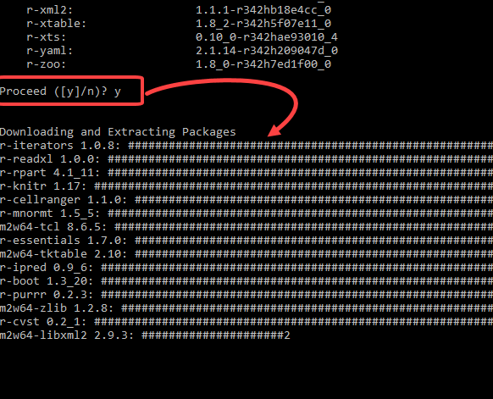

Slide 14
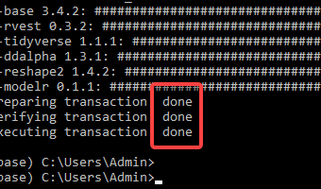
Installation will take time, and you will get done message.

Slide 15
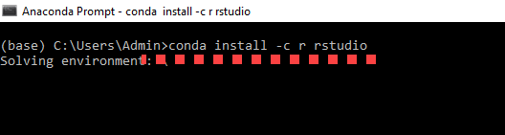
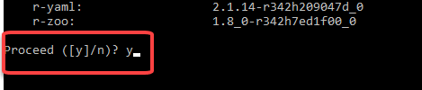
Install Rstudio

Slide 16
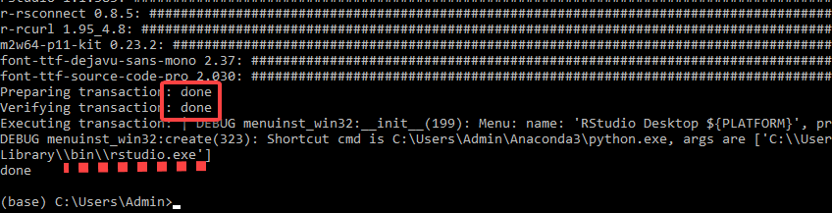
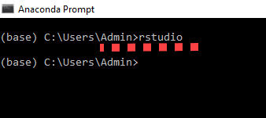
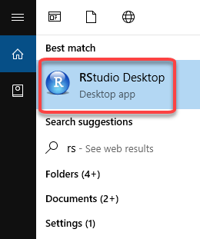

Slide 17
R Data Types, Arithmetic & Logical Operators with Example
Basic data types: R Programming works with numerous data types, including
Scalars
Vectors (numerical, character, logical)
Matrices
Data frames
Lists
Basics types
4.5 is a decimal value called numerics.
4 is a natural value called integers. Integers are also numerics.
TRUE or FALSE is a Boolean value called logical.
The value inside " " or ' ' are text (string). They are called characters.

Slide 18
Example 1:
# Numeric
x <- 28
class(x)
Output:
## [1] "numeric"
Example 2:
# String
y <- "R is Fantastic"
class(y)
Output:
## [1] "character"
Example 3:
# Boolean
z <- TRUE
class(z)
Output:
## [1] "logical"

Slide 19
Variables
A variable can store a number, an object, a statistical result, vector, dataset, a model prediction..
basically anything R outputs.
To add a value to the variable, use <- or =.
name_of_variable <- value
name_of_variable = value
Example 1:
# Print variable x
x <- 42
x
Output:
## [1] 42
y <- 10
# We call x and y and apply a subtraction
x-y
Output:
## [1] 32

Slide 20
Variables
Using variables 1
What is the sum of the first n positive integers?
We can use the formula n(n+1)/2
to quickly compute this quantity.
Instructions
Define n<-100
Then use R to compute the sum of 1 through 100 using the formula n(n+1)/2
. What is the sum?
# Here is how you compute the sum for the first 20 integers: 20*(20+1)/2
# However, we can define a variable to use the formula for other values of nn <- 100n*(n+1)/2

Slide 21
Variables
Run the following code in the R console:
n <- 1000
x <- seq(1,n)
sum(x)
Based on the result, what do you think the functions seq and sum do? You can use the help system.
sum creates a list of numbers and seq adds them up.
seq creates a list of numbers and sum adds them up.
seq computes the difference between two arguments and sum computes the sum of 1 through 1000.
sum always returns the same number

Slide 22
Vectors
A vector is a one-dimensional array.
We can create a vector with all the basic data types (we discussed earlier).
The simplest way to build a vector in R, is to use the c command.
Example 1:
# Numerical
vec_num <- c(1, 10, 49)
vec_num
Output:
## [1] 1 10 49
Example 2:
# Character
vec_chr <- c("a", "b", "c")
vec_chr
Output:
## [1] "a" "b" "c"
Example 3:
# Boolean
vec_bool <- c(TRUE, FALSE, TRUE)
vec_bool
Output:
##[1] TRUE FALSE TRUE

Slide 23
Vectors
Example 4:
# Create the vectors
vect_1 <- c(1, 3, 5)
vect_2 <- c(2, 4, 6)
# Take the sum of A_vector and B_vector
sum_vect <- vect_1 + vect_2
# Print out total_vector
sum_vect
Output:
[1] 3 7 11
Example 5:
In R, it is possible to slice a vector.
In some occasion, we are interested in only the first five rows of a vector.
We can use the [1:5] command to extract the value 1 to 5.
# Slice the first five rows of the vector
slice_vector <- c(1,2,3,4,5,6,7,8,9,10)
slice_vector[1:5]
Output:
## [1] 1 2 3 4 5

Slide 24
Vectors
The shortest way to create a range of value is to use the: between two numbers.
For instance, from the above example, we can write c(1:10) to create a vector of value from one to ten.
# Faster way to create adjacent values
c(1:10)
Output:
## [1] 1 2 3 4 5 6 7 8 9 10

Slide 25
Arithmetic Operators
Basic arithmetic operations in R.
Operator Description
+ Addition
- Subtraction
* Multiplication
/ Division
^ or ** Exponentiation
# Exponentiation
2^5
Output:
## [1] 32
# Modulo
28%%6
Output:
## [1] 4

Slide 26
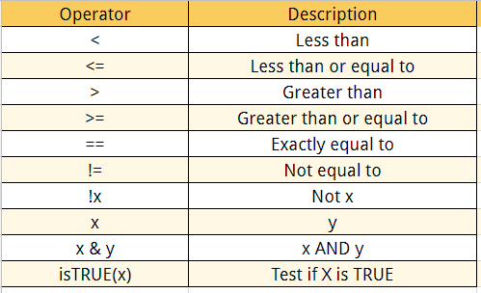
Logical Operators

Slide 27
Logical Operators
Example 1:
# Create a vector from 1 to 10
logical_vector <- c(1:10)
logical_vector>5
Output:
## [1]FALSE FALSE FALSE FALSE FALSE TRUE TRUE TRUE TRUE TRUE
R reads each value and compares it to the statement logical_vector>5.
If the value is strictly superior to five, then the condition is TRUE, otherwise FALSE.
R returns a vector of TRUE and FALSE.

Slide 28
Logical Operators
Example 2:
We want to extract the values that is strictly superior to five’.
For that, we can wrap the condition inside a square bracket precede by the vector containing the values.
# Print value strictly above 5
logical_vector[(logical_vector>5)]
Output:
## [1] 6 7 8 9 10

Slide 29
Logical Operators
Example 3:
# Print 5 and 6
logical_vector <- c(1:10)
logical_vector[(logical_vector>4) & (logical_vector<7)]
Output:
## [1] 5 6

Slide 30
What is a Matrix?
A matrix is a 2-dimensional array that has m number of rows and n number of columns.
Matrix is a combination of two or more vectors with the same data type.
How to Create a Matrix in R
We can create a matrix with the function matrix(). This function takes three arguments:
matrix(data, nrow, ncol, byrow = FALSE)
Arguments:
data: The collection of elements that R will arrange into the rows and columns of the matrix
nrow: Number of rows
ncol: Number of columns
byrow: The rows are filled from the left to the right. We use `byrow = FALSE` (default values), if we want the matrix to be filled by the columns i.e. the values are filled top to bottom.

Slide 31
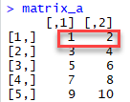
Matrix Creation
Let's construct two 5x2 matrix with a sequence of number from 1 to 10, one with byrow = TRUE and one with byrow = FALSE to see the difference.
matrix_a <-matrix(1:10, byrow = TRUE, nrow = 5)
matrix_a
# Print dimension of the matrix with dim()
dim(matrix_a)
Output:
## [1] 5 2
Output:

Slide 32
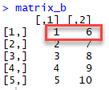
Matrix Creation
# Construct a matrix with 5 rows that contain the numbers 1 up to 10 and byrow = FALSE
matrix_b <-matrix(1:10, byrow = FALSE, nrow = 5)
matrix_b
Output:

Slide 33
Matrix Creation
You can also create a 4x3 matrix using ncol. R will create 3 columns and fill the row from top to bottom. Check an example
matrix_c <-matrix(1:12, byrow = FALSE, ncol = 3)
matrix_c
Output:
## [,1] [,2] [,3]
## [1,] 1 5 9
## [2,] 2 6 10
## [3,] 3 7 11
## [4,] 4 8 12
dim(matrix_c)
Output:
## [1] 4 3

Slide 34
Add a Column to a Matrix with the cbind()
Example:
# concatenate c(1:5) to the matrix_a
matrix_a1 <- cbind(matrix_a, c(1:5))
# Check the dimension
dim(matrix_a1)
Output:
## [1] 5 3
Example:
matrix_a1
Output
## [,1] [,2] [,3]
## [1,] 1 2 1
## [2,] 3 4 2
## [3,] 5 6 3
## [4,] 7 8 4
## [5,] 9 10 5

Slide 35
Adding Columns to a Matrix with the matrix()
We can also add more than one column.
Let's see the next sequence of number to the matrix_a2 matrix.
The dimension of the new matrix will be 4x6 with number from 1 to 24.
matrix_a2 <-matrix(13:24, byrow = FALSE, ncol = 3)
Output:
## [,1] [,2] [,3]
## [1,] 13 17 21
## [2,] 14 18 22
## [3,] 15 19 23
## [4,] 16 20 24

Slide 36
Matrix Operations
Example:
matrix_a2 <-matrix(13:24, byrow = FALSE, ncol = 3)
matrix_c <-matrix(1:12, byrow = FALSE, ncol = 3)
matrix_d <- cbind(matrix_a2, matrix_c)
dim(matrix_d)
Output:
## [1] 4 6
Note: The number of rows of matrices should be equal for cbind work

Slide 37
Matrix Operations
cbind()concatenate columns, rbind() appends rows.
Let's add one row to our matrix_c matrix and verify the dimension is 5x3
matrix_c <-matrix(1:12, byrow = FALSE, ncol = 3)
# Create a vector of 3 columns
add_row <- c(1:3)
# Append to the matrix
matrix_c <- rbind(matrix_c, add_row)
# Check the dimension
dim(matrix_c)
Output:
## [1] 5 3

Slide 38
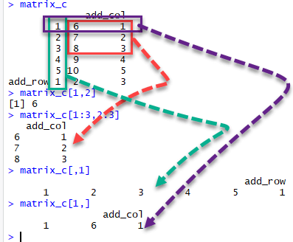
Slice a Matrix
We can select elements one or many elements from a matrix by using the square brackets [ ].
For example:
matrix_c[1,2] selects the element at the first row and second column.
matrix_c[1:3,2:3] results in a matrix with the data on the rows 1, 2, 3 and columns 2, 3,
matrix_c[,1] selects all elements of the first column.
matrix_c[1,] selects all elements of the first row.

Slide 39
What is Factor in R?
Factors are variables in R which take on a limited number of different values; such variables are often referred to as categorical variables.
In a dataset, we can distinguish two types of variables: categorical and continuous.
In a categorical variable, the value is limited and usually based on a particular finite group.
For example, a categorical variable can be countries, year, gender, occupation.
A continuous variable, however, can take any values, from integer to decimal.
For example, we can have the revenue, price of a share, etc..

Slide 40
What is Factor in R?
It is important to transform a string into factor when we perform Machine Learning task.
Categorical Variables
R stores categorical variables into a factor.
The code below to convert a character variable into a factor variable.
Characters are not supported in machine learning algorithm, and the only way is to convert a string to an integer.
factor(x = character(), levels, labels = levels, ordered = is.ordered(x))
Arguments:
x: A vector of data. Need to be a string or integer, not decimal.
Levels: A vector of possible values taken by x. This argument is optional. The default value is the unique list of items of the vector x.
Labels: Add a label to the x data. For example, 1 can take the label `male` while 0, the label `female`.
ordered: Determine if the levels should be ordered.

Slide 41
Let's create a factor data frame.
# Create gender vector
gender_vector <- c("Male", "Female", "Female", "Male", "Male")
class(gender_vector)
# Convert gender_vector to a factor
factor_gender_vector <-factor(gender_vector)
class(factor_gender_vector)
Output:
## [1] "character"
## [1] "factor"
It is important to transform a string into factor when we perform Machine Learning task.

Slide 42
Factor in R?
A categorical variable can be divided into nominal categorical variable and ordinal categorical variable.
Nominal Categorical Variable:
A categorical variable has several values but the order does not matter.
For instance, male or female categorical variable do not have ordering.
# Create a color vector
color_vector <- c('blue', 'red', 'green', 'white', 'black', 'yellow')
# Convert the vector to factor
factor_color <- factor(color_vector)
factor_color
Output:
## [1] blue red green white black yellow
## Levels: black blue green red white yellow

Slide 43
Factor in R?
Ordinal Categorical Variable
Ordinal categorical variables do have a natural ordering. We can specify the order, from the lowest to the highest with order = TRUE and highest to lowest with order = FALSE.
We can use summary to count the values for each factor.
# Create Ordinal categorical vector
day_vector <- c('evening', 'morning', 'afternoon', 'midday', 'midnight', 'evening')
# Convert `day_vector` to a factor with ordered level
factor_day <- factor(day_vector, order = TRUE, levels =c('morning', 'midday', 'afternoon', 'evening', 'midnight'))
# Print the new variable
factor_day
Output:
## [1] evening morning afternoon midday midnight evening

Slide 44
Ordinal Categorical Variable
Example:
## Levels: morning < midday < afternoon < evening < midnight
# Append the line to above code
# Count the number of occurence of each level
summary(factor_day)
Output:
## morning midday afternoon evening midnight
## 1 1 1 2 1
R ordered the level from 'morning' to 'midnight' as specified in the levels parenthesis.

Slide 45
Continuous Variables
Continuous class variables are the default value in R.
They are stored as numeric or integer.
mtcars is a built-in dataset. It gathers information on different types of car.
We can import it by using mtcars and check the class of the variable mpg, mile per gallon.
It returns a numeric value, indicating a continuous variable.
dataset <- mtcars
class(dataset$mpg)
Output
## [1] "numeric"

Slide 46
What is a Data Frame?
A data frame is a list of vectors which are of equal length.
A matrix contains only one type of data, while a data frame accepts different data types (numeric, character, factor, etc.).
How to Create a Data Frame
We can create a data frame by passing the variable a,b,c,d into the data.frame() function.
We can name the columns with name() and simply specify the name of the variables.
data.frame(df, stringsAsFactors = TRUE)
Arguments:
df: It can be a matrix to convert as a data frame or a collection of variables to join
stringsAsFactors: Convert string to factor by default

Slide 47
Creating a Data Frame
We can create our first data set by combining four variables of same length.
# Create a, b, c, d variables
a <- c(10,20,30,40)
b <- c('book', 'pen', 'textbook', 'pencil_case')
c <- c(TRUE,FALSE,TRUE,FALSE)
d <- c(2.5, 8, 10, 7)
# Join the variables to create a data frame
df <- data.frame(a,b,c,d)
df
Output:
## a b c d
## 1 1 book TRUE 2.5
## 2 2 pen TRUE 8.0
## 3 3 textbook TRUE 10.0
## 4 4 pencil_case FALSE 7.0
We can see the column headers have the same name as the variables.

Slide 48
We can change the column name with the function names().
# Name the data frame
names(df) <- c('ID', 'items', 'store', 'price')
df
Output:
## ID items store price
## 1 10 book TRUE 2.5
## 2 20 pen FALSE 8.0
## 3 30 textbook TRUE 10.0
## 4 40 pencil_case FALSE 7.0
# Print the structure
str(df)
Output:
## a b c d
## 1 1 book TRUE 2.5
## 2 2 pen TRUE 8.0
## 3 3 textbook TRUE 10.0
## 4 4 pencil_case FALSE 7.0

Slide 49
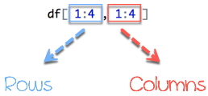
Slice Data Frame
A data frame is composed of rows and columns, df[A, B].
A represents the rows and B the columns.
It is possible to SLICE values of a Data Frame.
We can slice either by specifying the rows and/or columns.
We select the rows and columns to return into bracket precede by the name of the data frame.
From picture 1, the left part represents the rows, and the right part is the columns.

Slide 50
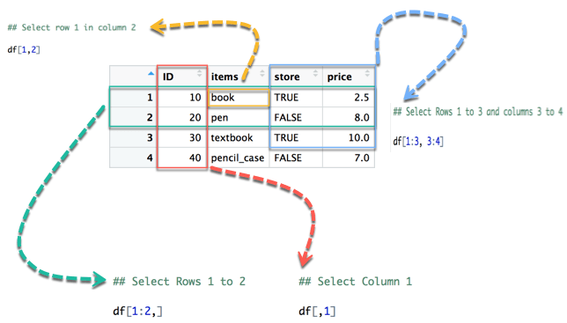
Slice Data Frame
In below diagram we display how to access different selection of the data frame:
The yellow arrow selects the row 1 in column 2
The green arrow selects the rows 1 to 2
The red arrow selects the column 1
The blue arrow selects the rows 1 to 3 and columns 3 to 4
Note that, if we let the left part blank, R will select all the rows. By analogy, if we let the right part blank, R will select all the columns.

Slide 52
Slice Data Frame
## Select row 1 in column 2
df[1,2]
Output:
## [1] book
## Levels: book pen pencil_case textbook
## Select Rows 1 to 2
df[1:2,]
Output:
## ID items store price
## 1 10 book TRUE 2.5
## 2 20 pen FALSE 8.0
## Select Columns 1
df[,1]
Output:
## [1] 10 20 30 40
## Select Rows 1 to 3 and columns 3 to 4
df[1:3, 3:4]
Output:
## store price
## 1 TRUE 2.5
## 2 FALSE 8.0
## 3 TRUE 10.0

Slide 53
Slice Data Frame
It is also possible to select the columns with their names. For instance, the code below extracts two columns: ID and store.
# Slice with columns name
df[, c('ID', 'store')]
Output:
## ID store
## 1 10 TRUE
## 2 20 FALSE
## 3 30 TRUE
## 4 40 FALSE

Slide 54
Slice Data Frame
Append a Column to Data Frame
You can also append a column to a Data Frame. You need to use the symbol $ to append a new variable.
# Create a new vector
quantity <- c(10, 35, 40, 5)
# Add `quantity` to the `df` data frame
df$quantity <- quantity
df
Output:
## ID items store price quantity
## 1 10 book TRUE 2.5 10
## 2 20 pen FALSE 8.0 35
## 3 30 textbook TRUE 10.0 40
## 4 40 pencil_case FALSE 7.0 5

Slide 55
Slice Data Frame
Select a Column of a Data Frame
Sometimes, we need to store a column of a data frame for future use or perform operation on a column.
We can use the $ sign to select the column from a data frame.
# Select the column ID
df$ID
Output:
## [1] 1 2 3 4

Slide 56
Subset a Data Frame
In the previous section, we selected an entire column without condition.
It is possible to subset based on whether or not a certain condition was true.
We use the subset() function.
subset(x, condition)
arguments:
- x: data frame used to perform the subset
- condition: define the conditional statement

Slide 57
Subset a Data Frame
We want to return only the items with price above 10, we can do:
# Select price above 5
subset(df, subset = price > 5)
Output:
ID items store price
2 20 pen FALSE 8
3 30 textbook TRUE 10
4 40 pencil_case FALSE 7

